Slide 1
Fall 2020 CSE4063 Fundamentals of Data Mining Project #2
- Turkıye student evaluatıon -
Osman Mantıcı

Slide 2
PROBLEM DEFINITION:
In this project, we constructed :
- 3 frequent pattern mining models:
Apriori - FP-Growth - ECLAT
- 3 clustering analysis methods:
K-Means - AGNES - DBSCAN
on "Turkiye Student Evaluation" dataset and compared their performances.

Slide 3
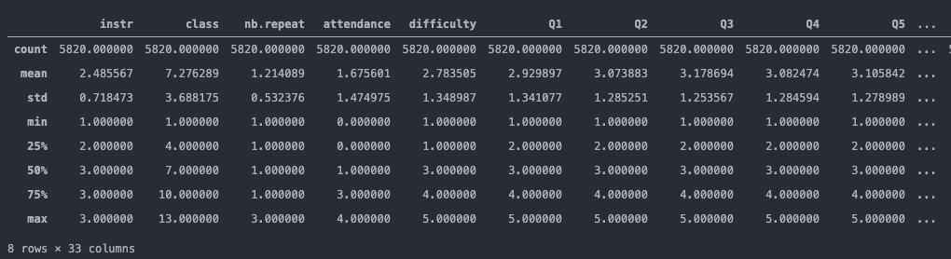
Turkiye Student Evaluation Dataset -2013/09/01-
This set contains a total 5820 evaluation scores provided by students from Gazi University in Ankara (Turkey). There is a total of 28 course specific questions and additional 5 attributes.

Slide 4
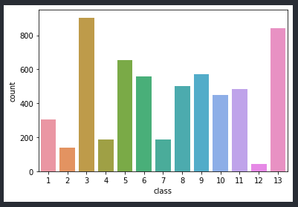
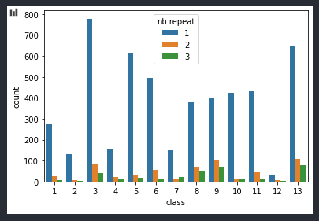
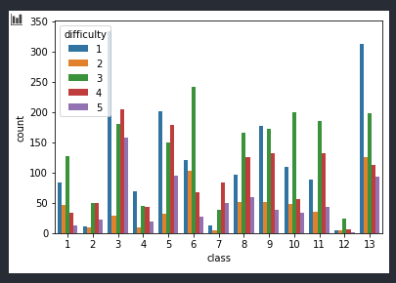
Attribute Information
instr: Instructor's identifier; values taken from {1,2,3} class: Course code (descriptor); values taken from {1-13} repeat: Number of times the student is taking this course; values taken from {0,1,2,3,...} attendance: Code of the level of attendance; values from {0, 1, 2, 3, 4} difficulty: Level of difficulty of the course as perceived by the student; values taken from {1,2,3,4,5}

Slide 5
Attribute Information
And 28 different questions: Q1-Q28 values are taken from {1,2,3,4,5}
Some question examples:
Q1: The semester course content, teaching method and evaluation system were provided at the start. Q2: The course aims and objectives were clearly stated at the beginning of the period. Q3: The course was worth the amount of credit assigned to it. ...
Q14: The Instructor came prepared for classes. Q15: The Instructor taught in accordance with the announced lesson plan. Q16: The Instructor was committed to the course and was understandable.
...
Q27: The Instructor provided solutions to exams and discussed them with students. Q28: The Instructor treated all students in a right and objective manner.

Slide 6
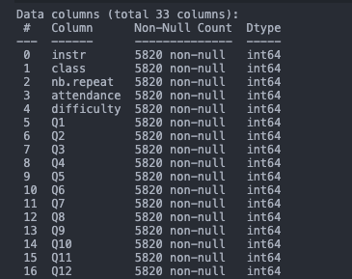
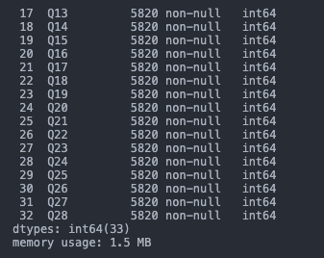
Data Pre-Processing / Cleaning
Our dataset contains 5820 rows * 33 columns
As you can see there is no missing values in our dataset.
That's why we did not do any cleaning operation.
We will explain transformation – normalization parts, on the construction parts.

Slide 7






Implementation
We used Jupyter Notebook & VS Code. Used libraries are :

Slide 8
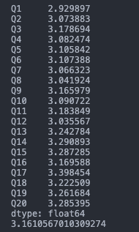
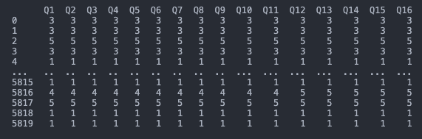
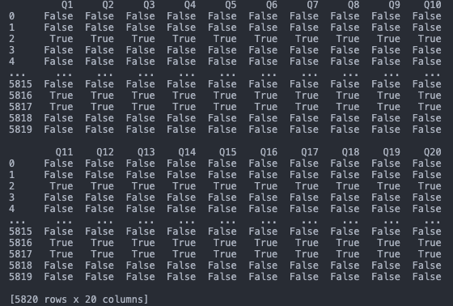
Transforming the data:
For the frequent pattern mining algorithms, we chosed the question columns as our dataset.
You can see from the figure on the left that, mean values of the questions are very close. So we decreased the size of our set by taking only the 20 questions from 28 questions. Because, otherwise operations was taking too long.
Taking 3 as threshold, we converted numerical values to boolean values to decide to decide if the score is high or not.

Slide 9
FREQUENT PATTERN MINING ALGORITHMS

Slide 10
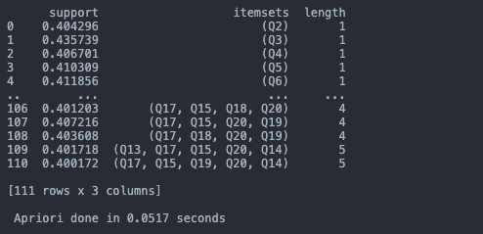
APRIORI
We used apriori method from "mlxtend" library for finding frequent pattern of questions.
frequent_itemsets = apriori(questions, min_support = 0.4, use_colnames = True)
We wanted to see the true columns.
Which means, student gave 4 or 5 points to: Q4-Q13-Q15-Q17 and Q20 together.
Q4: The course was taught according to the syllabus announced on the first day of class.
Q13: The Instructor's knowledge was relevant and up to date.
Q15: The Instructor taught in accordance with the announced lesson plan. Q17: The Instructor arrived on time for classes.
Q20: The Instructor explained the course and was eager to be helpful to students.

Slide 11
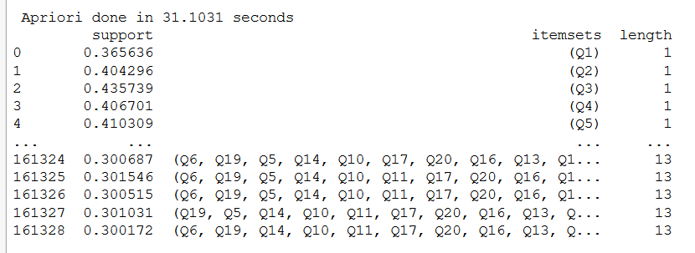
If we take min_support as 0.3:
We get frequent patterns which has 13 questions. It is meaningless to have that much questions in the patterns since we have 20 questions in total.

Slide 12
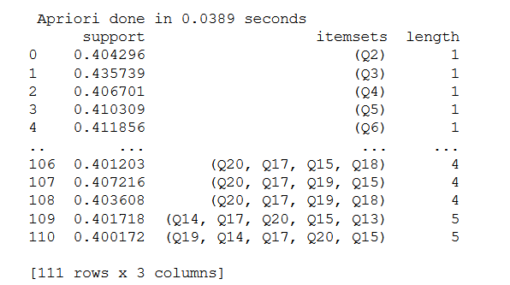
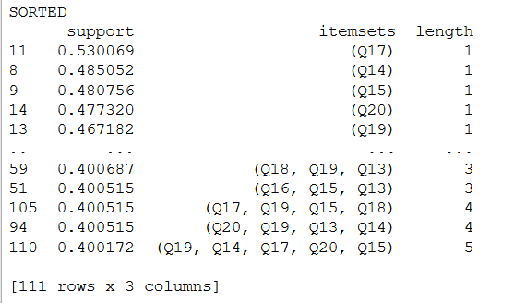
If we take min_support as 0.4:
Sorted by length of pattern:
Sorted by support value:

Slide 13
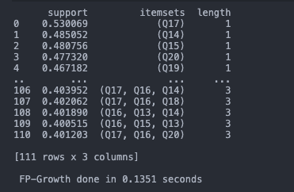
FP-GROWTH
We used "fpgrowth" method from "mlxtend" library for finding frequent pattern of questions.

Slide 14
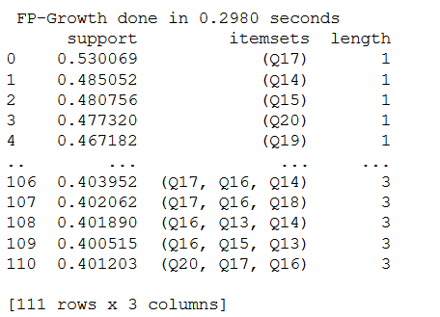

When we take the same min_support value with apriori which is 0.4:
Sorted by length of pattern:
Sorted by support value:

Slide 15
Required time for both "Apriori" & "Fp-Growth" is 0.2980 - 0.0389 respectively when min_support= 0.4
Required time for both "Apriori" & "Fp-Growth" is 31.1031-18.1324 respectively when min_support= 0.3
The performance of "Fp-Growth" better than "Apriori" when the data size respectively high. Because Fp-Growth is an array based algorithm and it requires just two database access, so in order to that information Fp-Growth takes less time than Apriori.

Slide 16
ECLAT
We used "association_rules" method from "mlxtend" library for finding frequent pattern of questions.
Again we use 0.4 min support in order to compare the performance of algorithms.

Slide 17
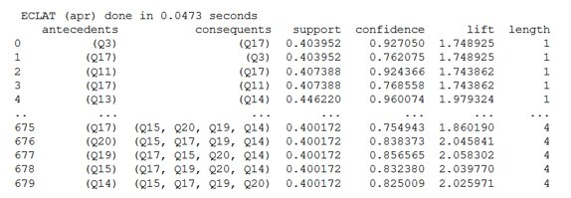
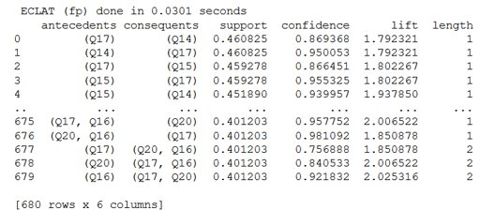
We used both of the itemsets that produced by Apriori and Fp – Growth.
When we use itemset from Fp – Growth, the Eclat takes less time than Apriori.

Slide 18
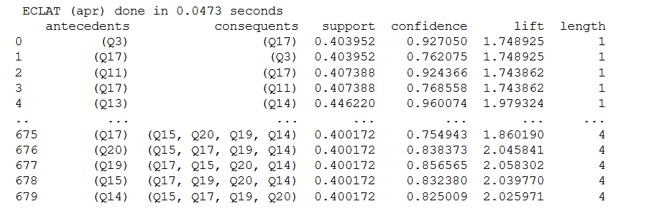
As we see, Q3 and Q17 have different confidence values eventhough they have the same support values.

Slide 19
COMPARING FREQUENT PATTERN MINING ALGORITHMS:
APRIORI
FP-GROWTH
ECLAT

Slide 20
Time Comparison
Minimum Support Values | 0.3 | 0.4
Apriori | 31.1031 | 0.0389
FP - Growth | 18.1324 | 0.2980
Eclat | - | 0.0473/0.0301

Slide 21
CLUSTERING ANALYSIS METHODS

Slide 22
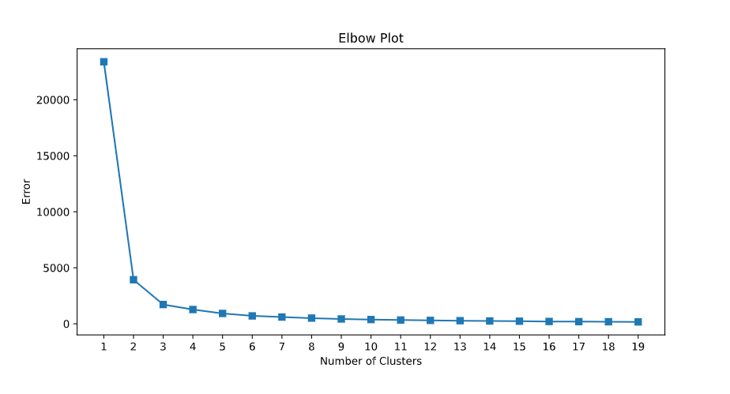
K-MEANS
We continued with first 20 questions also on the clustering algorithms.
To analyze the cluster size for the k-means algorithm, at first we created this elbow graph. And saw that 3 may be our number of clusters.

Slide 23
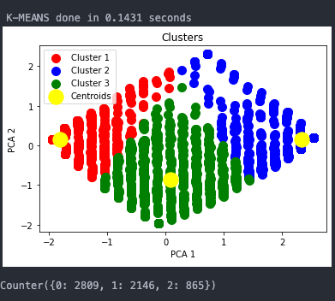
K-MEANS
Then with sklearn.cluster's KMeans library, we clustered our data. And we plotted the results:

Slide 24
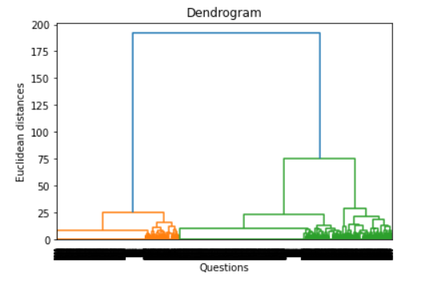
AGNES
We used linkage method from scipy library.
We plotted dendrogram to see how many clusters should we use.
We decide to take number of clusters as 3.

Slide 25
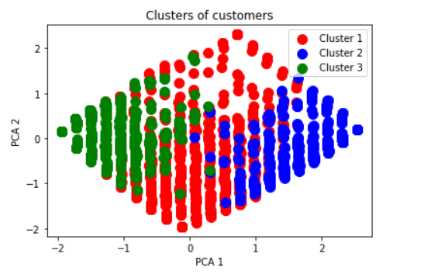

We used AgglomerativeClustering method from sklearn.cluster library.

Slide 26
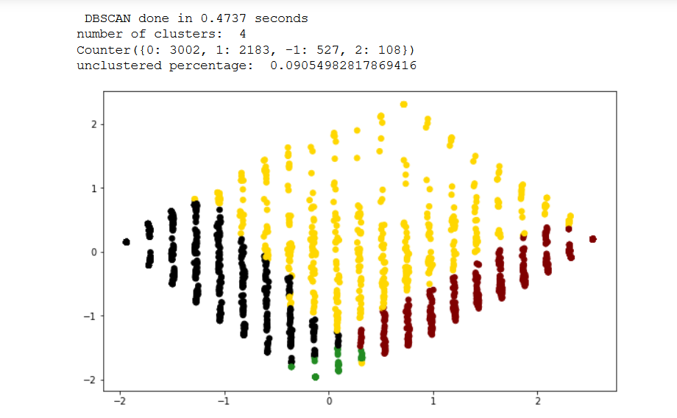
DBSCAN
We used DBSCAN method from sklearn.cluster library.
We have 3 clusters and 527 outliers.

Slide 27
COMPARING CLUSTERING ANALYSIS ALGORITHMS:
APRIORI
FP-GROWTH
ECLAT

Slide 28
Cluster Methods | Time
K-Means | 0.0676
Agnes | 3.6723
DB Scan | 0.4737

Slide 29
COMPARISION OF CLUSTERING METHODS
METHODS | HOMOGENITY | COMPLETENESS | V-MEASURE | SILHOUETTE
K-MEANS | 0.014 | 0.012 | 0.013 | 0.769
AGNES | 0.013 | 0.011 | 0.012 | 0.742
DB SCAN | 0.015 | 0.014 | 0.014 | 0.659

Slide 30
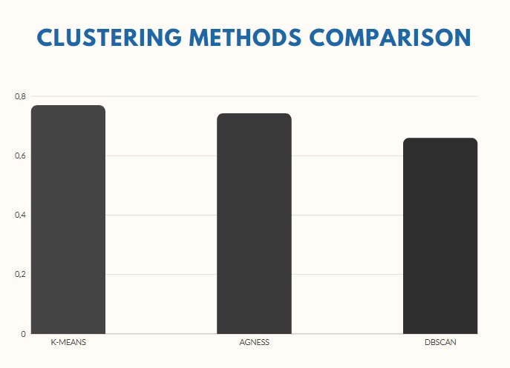
Silhouette Values of Methods

Slide 31
REFERENCES:
http://archive.ics.uci.edu/ml/datasets/turkiye+student+evaluation
http://rasbt.github.io/mlxtend/user_guide/frequent_patterns/apriori/
http://rasbt.github.io/mlxtend/user_guide/frequent_patterns/fpgrowth/

